Slide 1

INSY6212
Past Papers

Slide 2
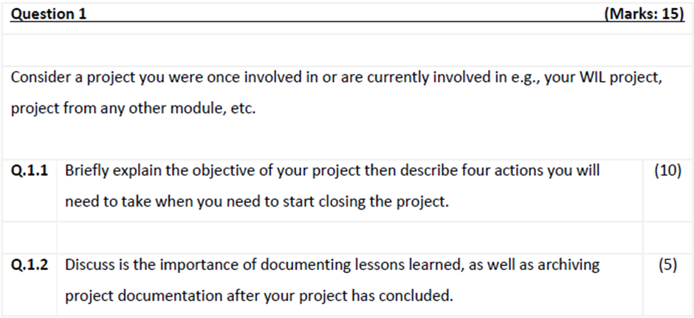
Paper 1

Slide 3
1.1. LU1 and LU4 (chapter 4 and 9)
Explain the project objective for 2 marks
Describe the project closing actions – 2 marks for each action explained
Collecting and making final payments
Recognising and evaluating staff
Conducting a post-project evaluation
Documenting lessons learnt
Organising and archiving project documents
1.2. LU4 (chapter 9 – page 316 and 317)
Discuss the importance of documenting lessons learnt – 2 marks
Discuss the importance of archiving project documentation – 2 marks
Link the discussions back to the identified project – 1 marks

Slide 4
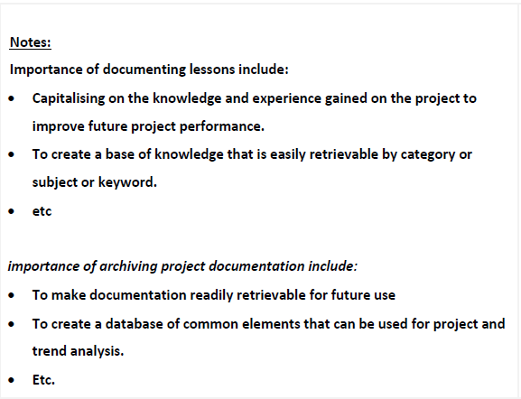

Slide 5
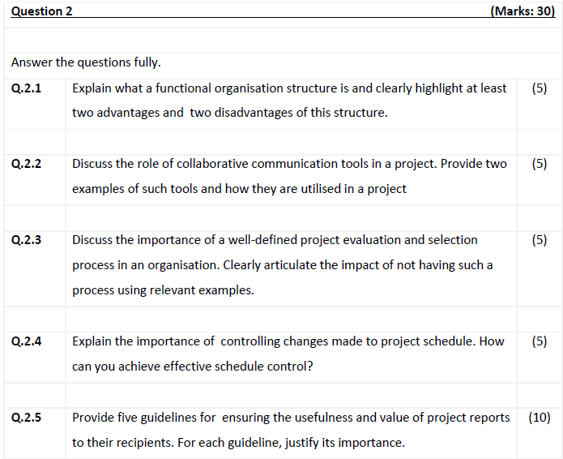

Slide 6
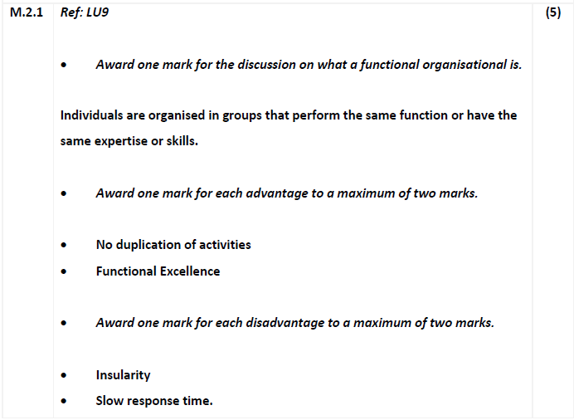

Slide 7
2.2. LU9
Collaborative Tools allow collaborative workspaces between members of the project team and subcontractors and customer to communicate and collaborate.
2.3. LU2
A well‐defined and well‐understood project evaluation and selection process increase the chances of making the best project decision
2.4. Chapter 5
So that the processes and procedures that define how changes to schedule will be documented, approved, and communicated can be managed.
To achieve effective schedule control, one must:
Analyse schedule to determine areas which may need corrective action.
Decide what specific corrective actions should be taken.
Revise the plan to incorporate chosen corrective action.
Recalculate the schedule to evaluate the effects of planned corrective actions.
2.5. Not covered in 2025 syllabus

Slide 8
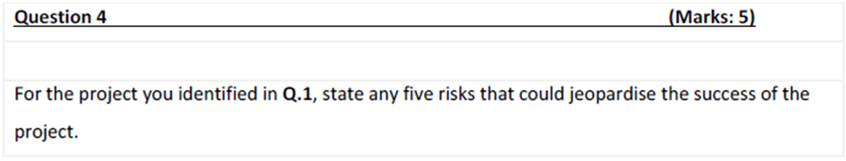
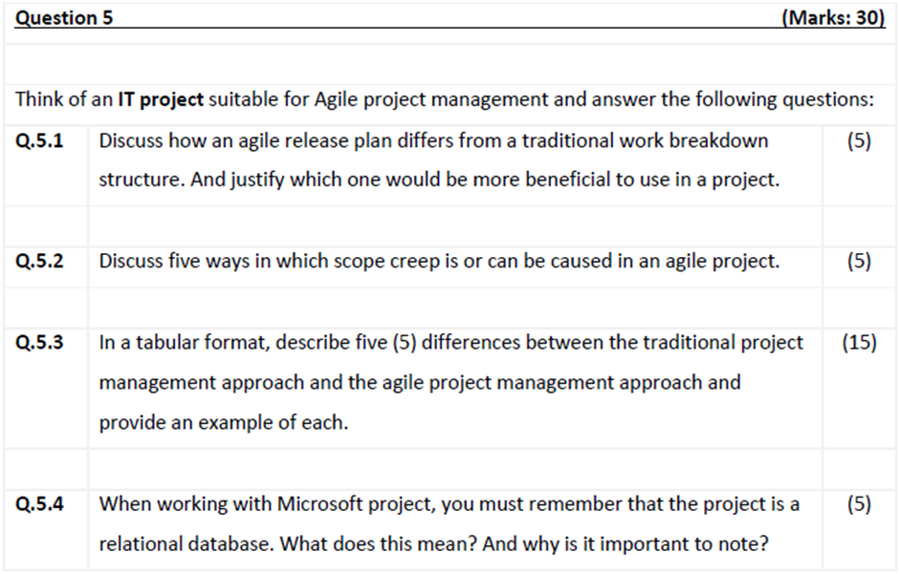

Slide 9
4. LU8 Chapter 8
Weather
Lack of funding
Lack of resources – skilled people, materials, facilities, etc
Changes to govt regulations
Protestors
Delays in approvals

Slide 10
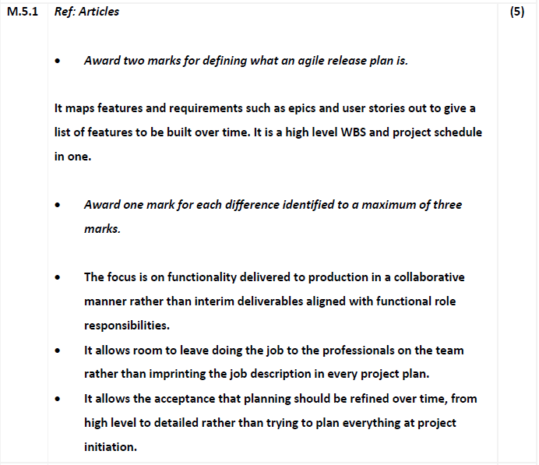

Slide 11
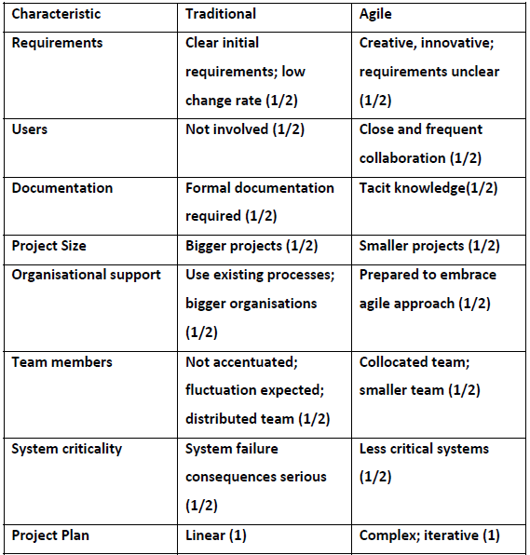
5.2.
Define what scope creep is and how it is caused in agile project management
5.3.

Slide 12
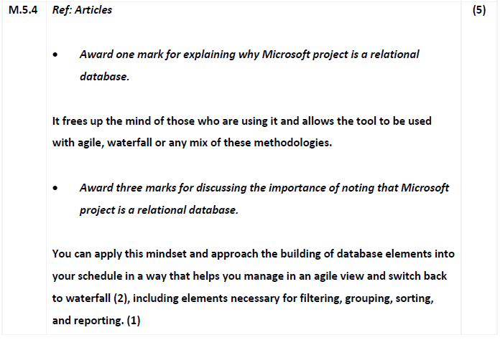

Slide 13
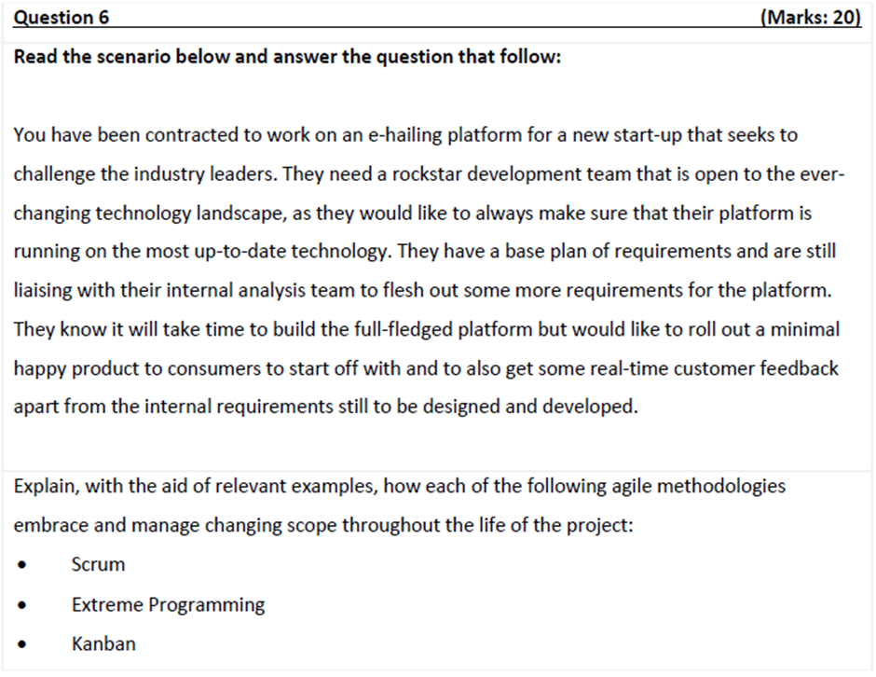

Slide 14
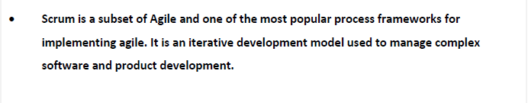
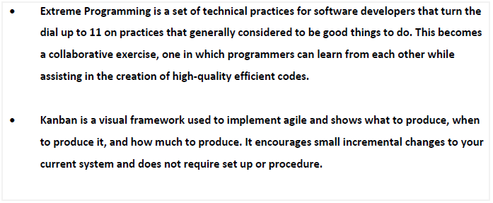

Slide 15
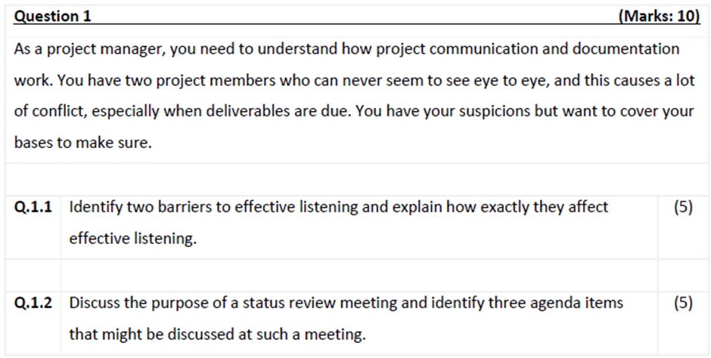
Paper 2

Slide 16
1.1. LU9
Pretending to listen
Distractions
Bias and closed-mindedness
Impatience
Jumping to conclusions
1 mark for each barrier and 2 marks for explaining how the barriers affect listening
1.2. Not covered in 2025 Syllabus

Slide 17
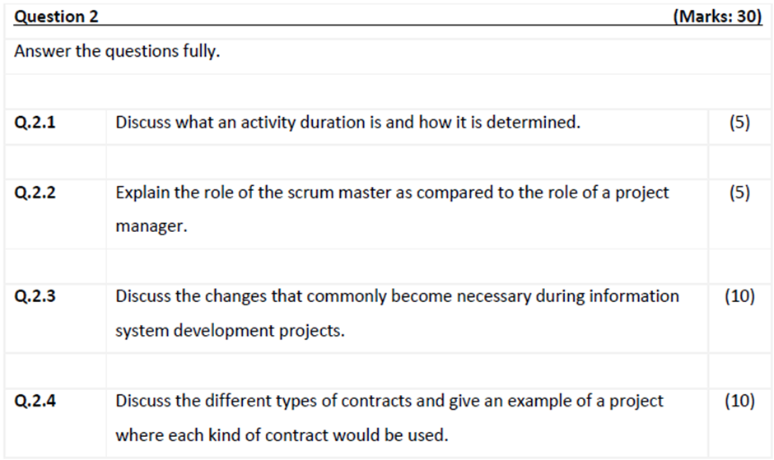

Slide 18
2.1. LU6 Chapter 6
Award two marks for discussing what an activity duration is
The total elapsed time for an activity
Award three marks for explaining how it is determined.
Once the types and quantities of resources are estimated for each activity, estimates can be made for how long it will take to perform each activity (2). It must be the total time for the work to be done plus any associated waiting time (1)
2.2. LU articles
Award two marks for defining what a scrum master is.
Award two marks for defining the role of a project manager.
Award one mark for differentiating the two roles.
2.3.
Award one mark for each change to a maximum of five marks
• Changes to the interface
• Changes to reports
• Changers to online queries
• Changes to software processing routines
• Changes to storage capacities
Award one mark for each change description to a maximum of five marks

Slide 19
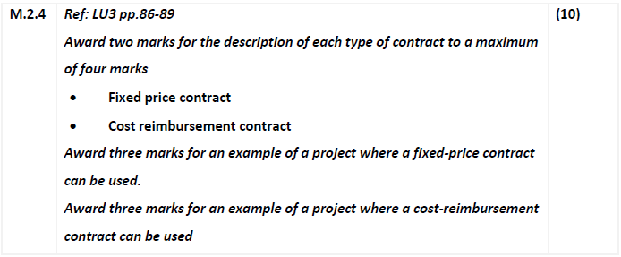

Slide 20
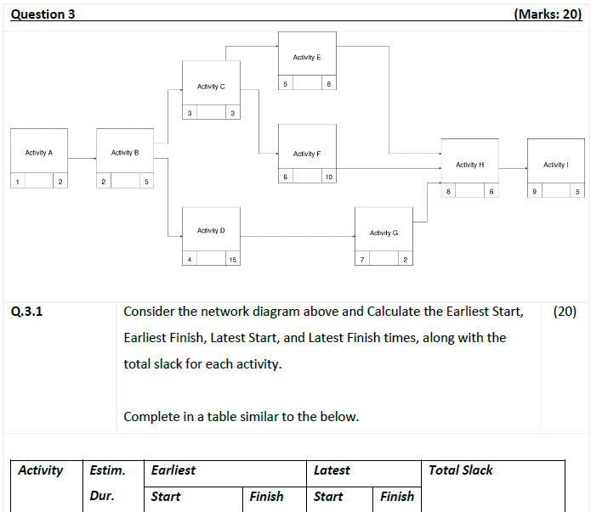

Slide 21
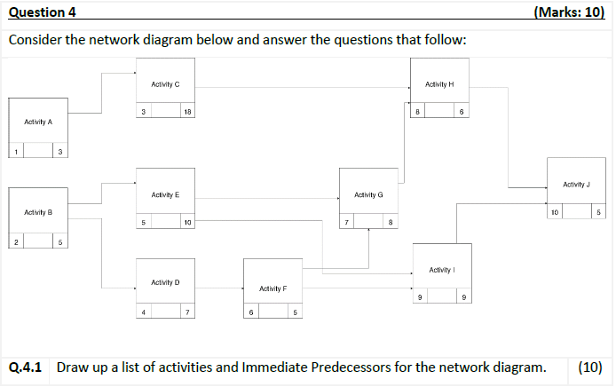

Slide 22
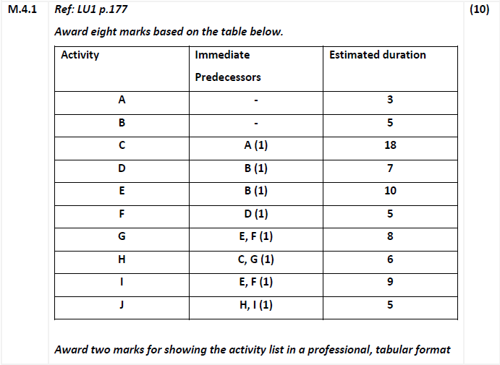

Slide 23
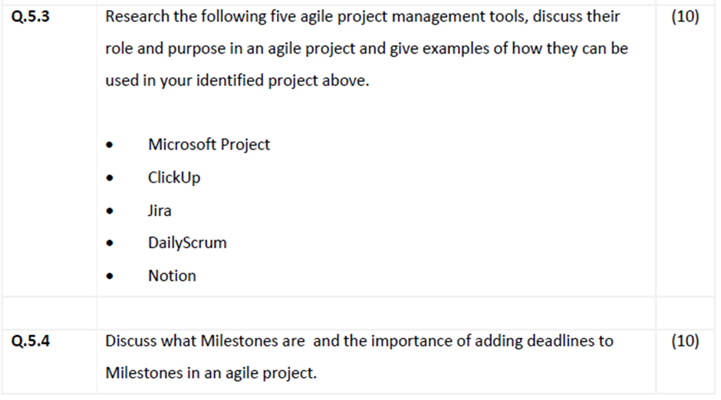

Slide 24
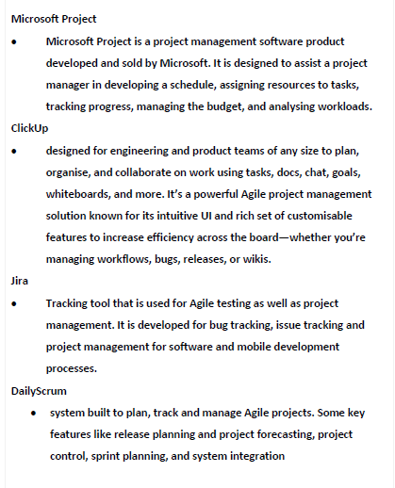
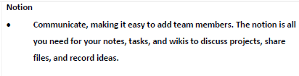

Slide 25
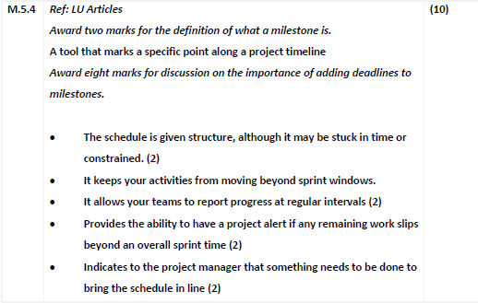

Slide 26
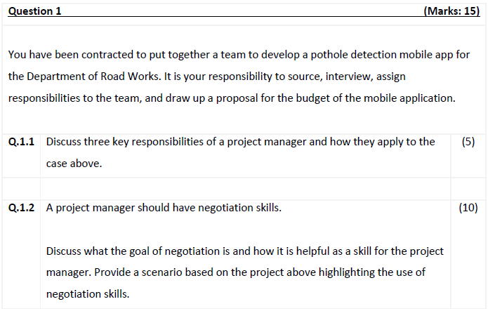
Paper 3

Slide 27
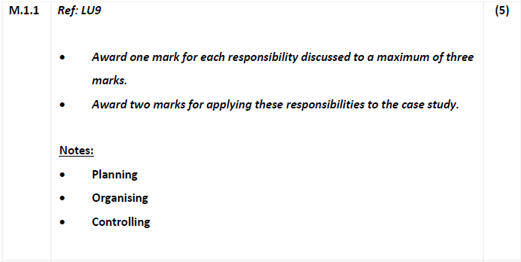

Slide 28
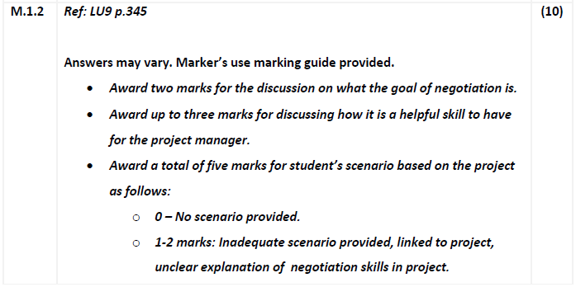
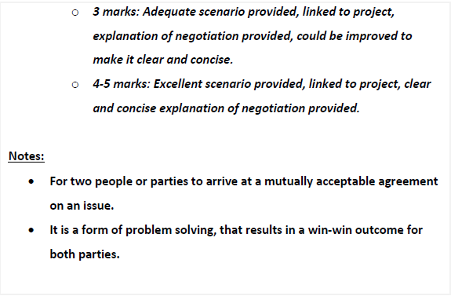

Slide 29
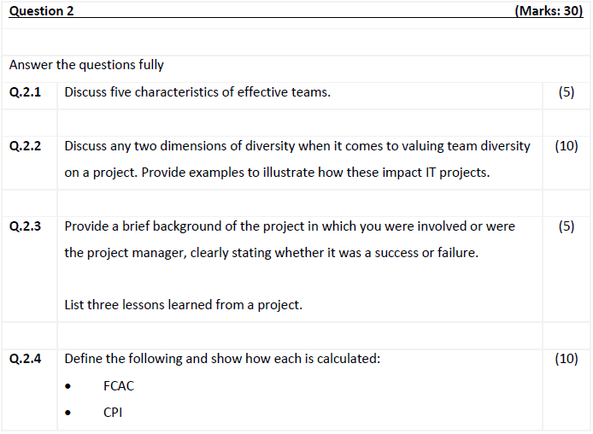

Slide 30
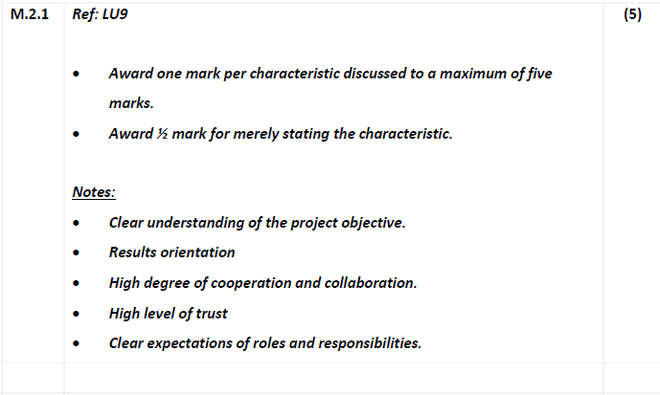

Slide 31
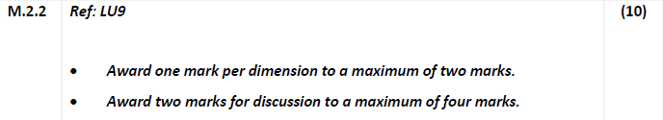
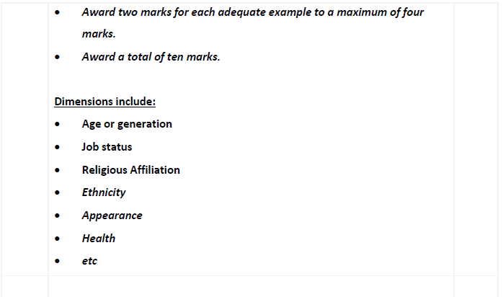

Slide 32
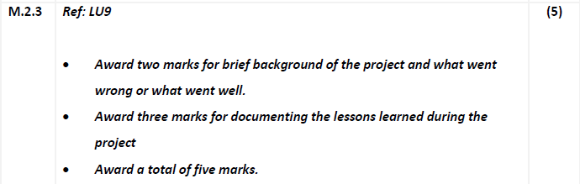

Slide 33
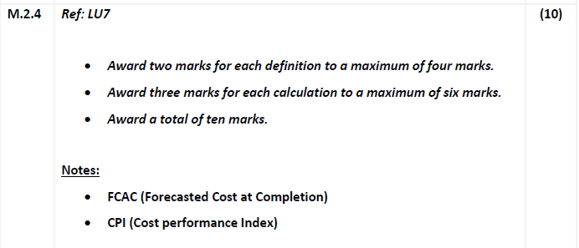
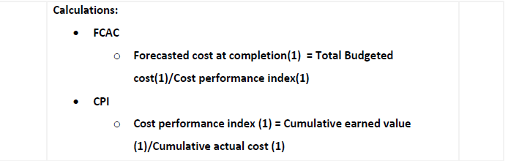

Slide 34
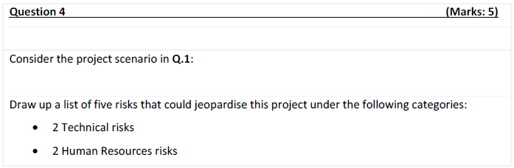

Slide 35
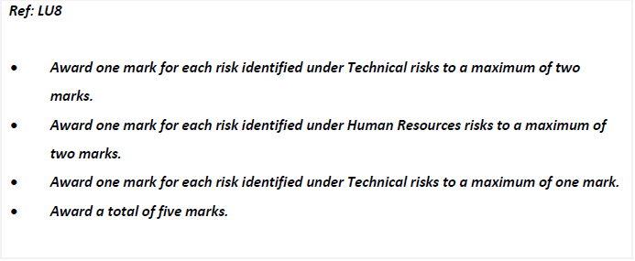
External

Slide 36
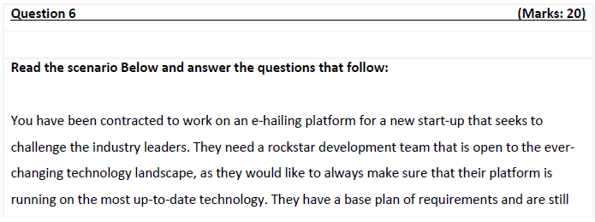
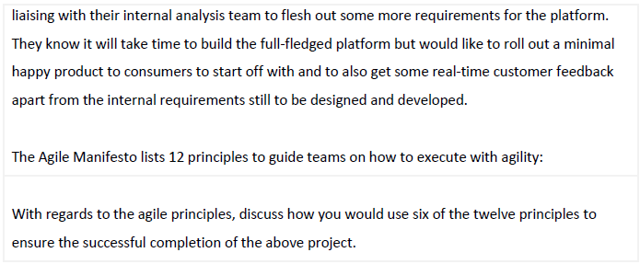

Slide 37
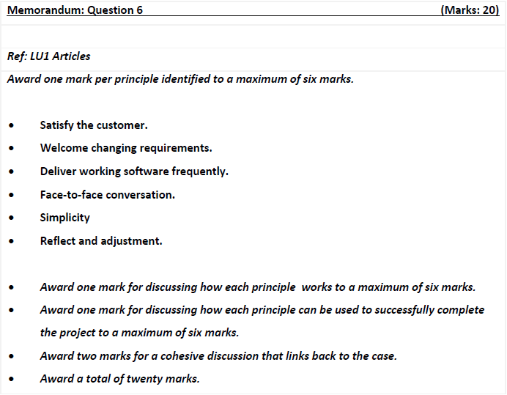

Slide 38
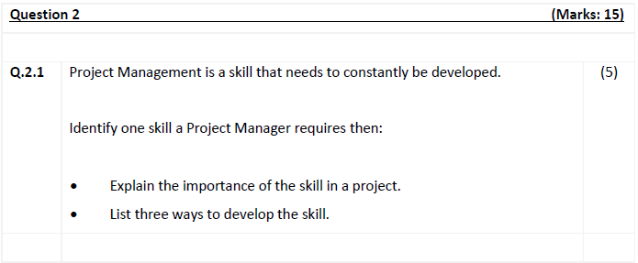
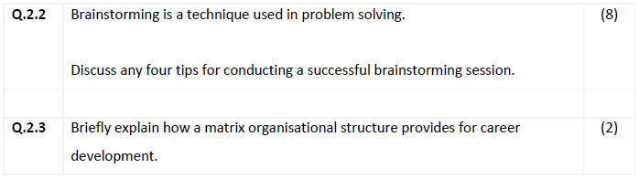
Paper 4: LU8 and LU7

Slide 39
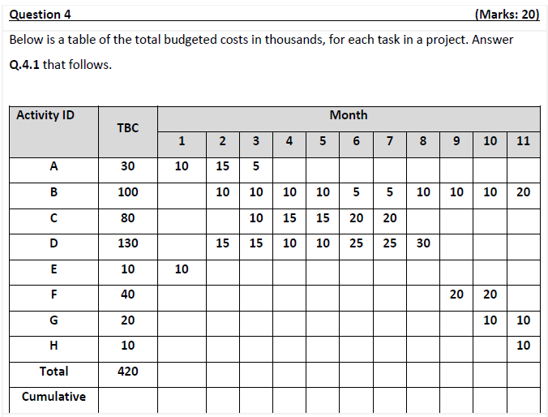

Slide 40
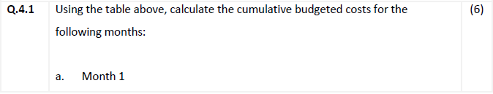
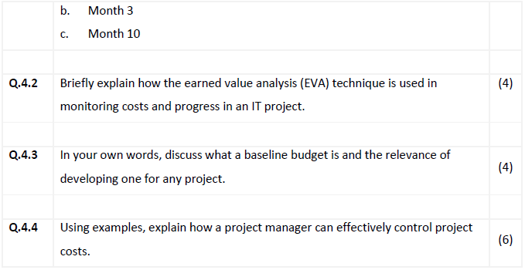

Slide 41
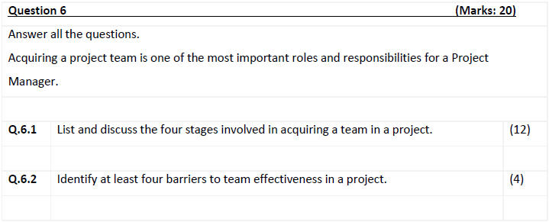
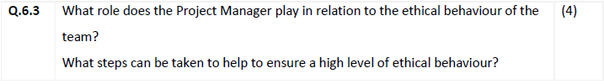
Paper 5: LU9

Slide 42
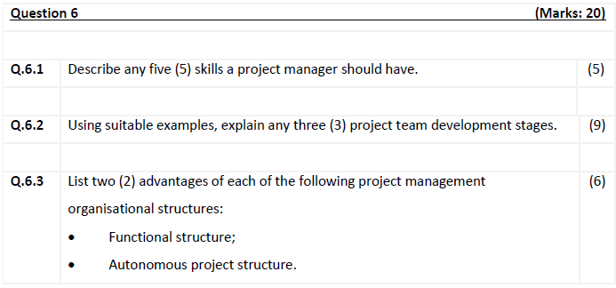
Paper 6: LU9

